Slide 1
AADHAAR
AUTHENTICATION
TEAM : VELAMMALIANS

Slide 2

STARTING LOGO PAGE
FIRST PAGE :
This is the first page (LOGO Page) of the app which is static for 1.5 seconds then automatically it go for login page.

Slide 3
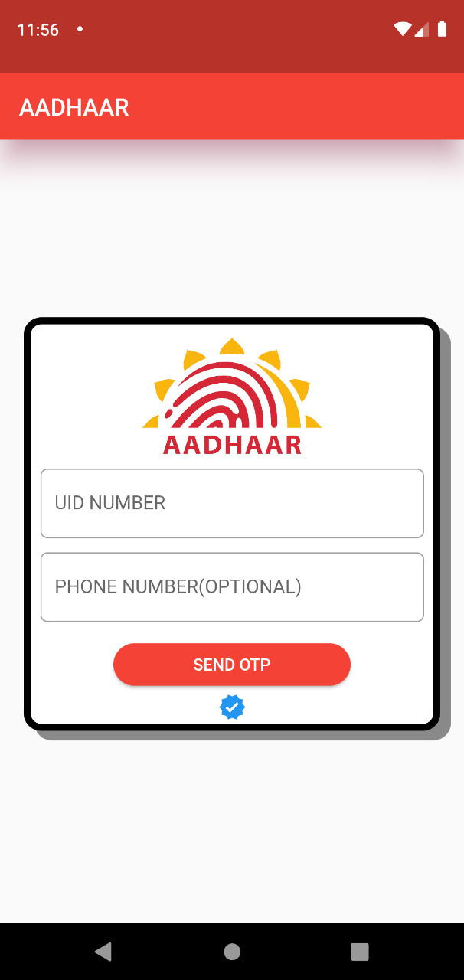
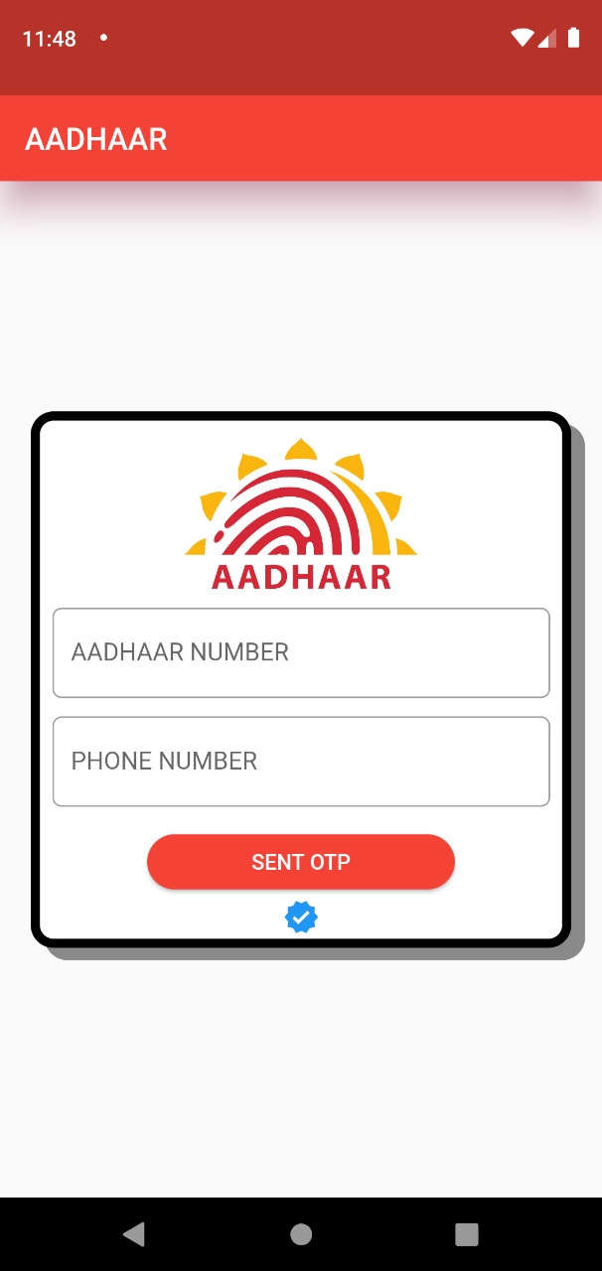
LOGIN PAGE
SECOND PAGE :
This is the second page ( LOGIN PAGE ) of the app .
After LOGO PAGE login page is open , we have to enter AADHAAR NUMBER ( UID number ) and phone number which is optional .
After entering AADHAAR number we have to click SENT OTP , and it goes to OTP VERIFICATION PAGE , then OTP number is automatically sent to the phone number which is registered to that particular AADHAAR number .

Slide 4
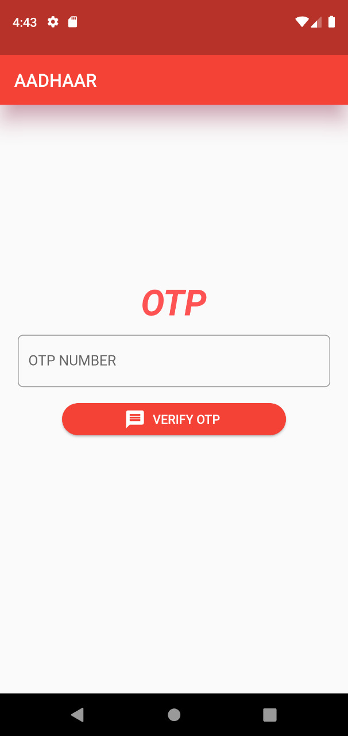
OTP VERIFICATION PAGE
THIRD PAGE :
This is the third page ( OTP VERIFICATION PAGE ) of the app .
In this page we have to enter the 6 digit OTP number which is sent to the mobile number registered with AADHAAR number , then we have to click VERIFY OTP .
If OTP matches it takes to DOCUMENT VERIFYING PAGE .
If OTP doesn’t matches is shows an error.

Slide 5
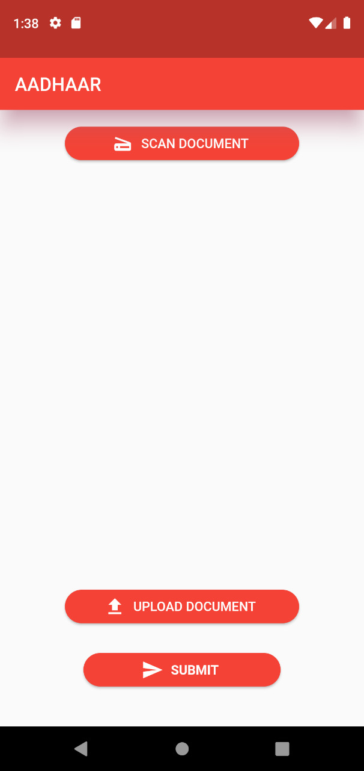
DOCUMENT VERIFYING PAGE
FOURTH PAGE - 1:
This is the fourth page ( DOCUMENT VERIFYING PAGE ) of the app .
First we need to scan document for address authentication .
If we click SCAN DOCUMENT it show small rectangular box to scan the documents which was having by the user .
The scan document process works on OCR Technology .
Suppose if the user doesn’t have any document to scan in hands there will be an another user friendly option to upload the document in the form of pdf or jpeg or jpg .
After uploading click SUBMIT …and it takes to ADDRESS UPDATION PAGE

Slide 6
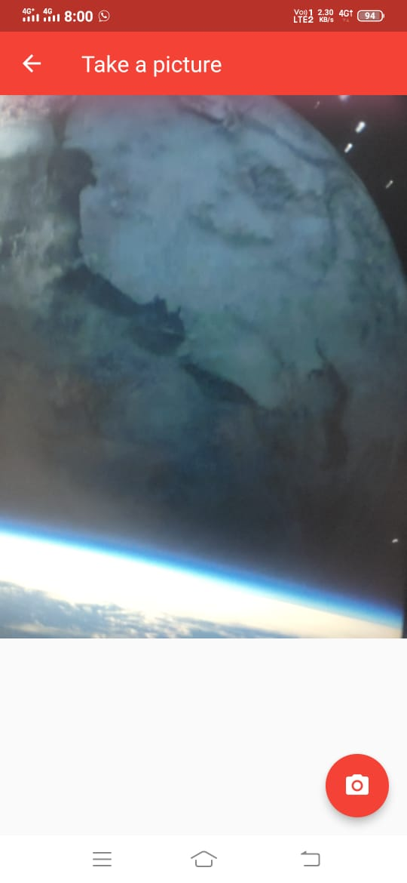
SCANNING DOCUMENT PAGE
FOURTH PAGE – 2 :
After clicking SCAN DOCUMENT from previous page it redirects to this current page .
First it asks permission for camera accessibility , after giving permission and by clicking camera icon below the page it captures image and stored it in the backend .
And these process are done using OCR technology

Slide 7
OCR TECHNOLOGY
Optical Character Regognition or Optical Character Reader is the electronic or mechanical conversion of images of typed , handwritten or printed text into machine – encoded text , whether from a scanned document , a photo of a document , a scene – photo or from subtitle text superimposed on an image .

Slide 8
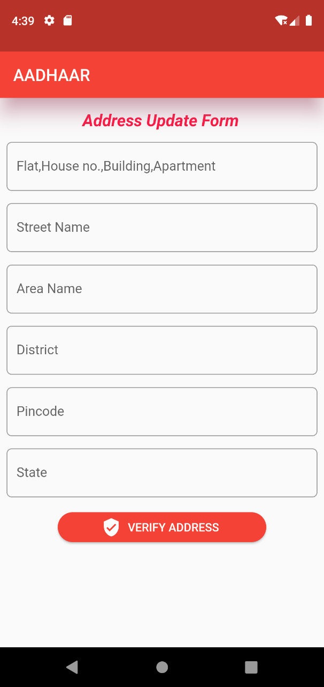
ADDRESS UPDATION PAGE
FIFTH PAGE :
This is the fifth page (ADDRESS UPDATION PAGE) of the app .
After Scanning / Uploading documents it redirects to address updation page .Here we have to fill the address we need to update Fill the boxes with suitable information then click the VERIFY ADDRESS .
After that , the combined information of texts from documents by OCR technology and geo location ( Live Location ) is compare with the address filled in address update form.
If it matches Updation will takes place and the update information is stored in data base. If it doesn’t matches it will show an error .
NOTE : The important thing is , we need to do all these steps in the same location we need to update .

Slide 9
GEO LOCATION
Geo Location refers to the use of location technologies such as GPS or IP addresses to identify and track the hereabouts of connected electronic devices .
Because these devices are often carried on an individual person’s , geolocation is often used to track the movements and location of people and surveillance .

Slide 10
By doing all the steps in the correct manner we are able to update our new address in our AADHAAR card .
Thank You

Slide 11
Thank you for giving us an opportunity to work on the Project and we are grateful for offering us so many opportunities to try out and we are so excited to do the same in future also . Regards from Team VELAMMALIANS

